Slide 1
Money Markets
Dr. Sarveshwar Kumar Inani
sarveshwarinani@wilp.bits-pilani.ac.in

Slide 2
Agenda:
Money Market Securities
Treasury bills (T-bills)
Commercial paper
Negotiable certificates of deposit (NCDs)
Repurchase agreements
Globalization of Money Markets
Eurodollar Securities

Slide 3
Money Market Securities
Money market securities are debt securities with a maturity of one year or less.
Issued by the US Treasury, Corporations, and financial intermediaries for short-term financing.
The Treasury and some corporations commonly pay off their debt from maturing money market securities with the proceeds from issuing new money market securities (Rolling basis).
Investors: Individuals via money market mutual funds, corporates, financial institutes, govt. departments.
Most money market securities are issued in very large denominations ($ 1 million), Hence, direct investing is not possible by retail investors.

Slide 4
Popular money
market securities
Treasury bills (T-bills)
Commercial paper
Negotiable certificates of deposit
Repurchase agreements
Federal funds

Slide 5
Treasury Bills (T-bills)
Issued by US Treasury when US govt. needs to borrow.
Released on weekly basis for different maturities (4-week, 13-week, and 26-week) via auction method online.
It also issues T-bills with a 1-year maturity on a monthly basis.
Investors: Banks, financial institutions, money market mutual funds, Corporations.
Credit Risk: Nil as issued by federal govt.
Liquidity is high due short-term maturity and strong secondary market.

Slide 6
Pricing: Treasury Bills (T-bills)
The par value (the amount received by investors at maturity) of T-bills is $1,000 and multiples of $1,000. Because T-bills do not pay interest, they are sold at a discount from par value, and the gain to the investor holding a T-bill until maturity is the difference between par value and the price paid.
Compute Fair value: If investors require a 4 percent annualized return on a one-year T-bill with a $10,000 par value, the price that they are willing to pay (fair value) is: 10000/1.04=9615.38.

Slide 7
Pricing: Treasury Bills (T-bills)
To price a T-bill with a maturity shorter than one year, the annualized return can be reduced by the fraction of the year in which funds will be invested.
Example: If investors require a 4 percent annualized return on a six-month T-bill, this reflects a 2 percent unannualized return over six months. The price that they will be willing to pay for a T-bill with a par value of $10,000 is therefore: 10000/1.02=9803.92

Slide 8
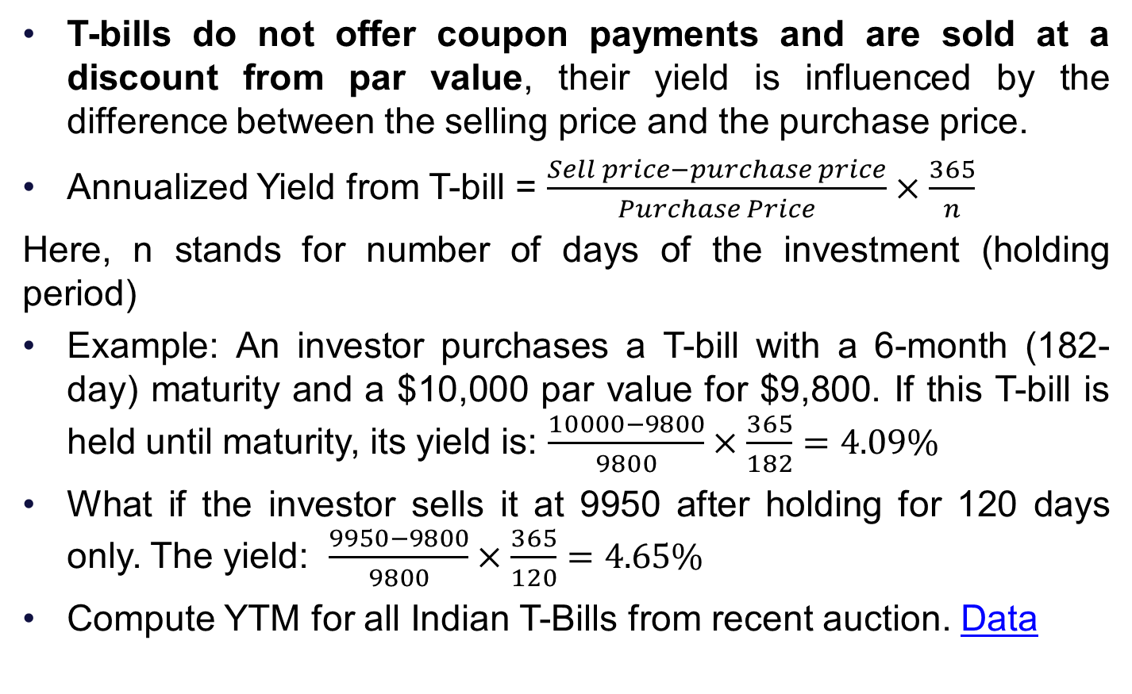
Yield: Treasury Bills (T-bills)
T-bills do not offer coupon payments and are sold at a discount from par value, their yield is influenced by the difference between the selling price and the purchase price.
Annualized Yield from T-bill = $\frac{Sell price−purchase price}{Purchase Price}×\frac{365}{n}$
Here, n stands for number of days of the investment (holding period)
Example: An investor purchases a T-bill with a 6-month (182-day) maturity and a $10,000 par value for $9,800. If this T-bill is held until maturity, its yield is: $\frac{10000−9800}{9800}×\frac{365}{182}=4.09\%$
What if the investor sells it at 9950 after holding for 120 days only. The yield: $\frac{9950−9800}{9800}×\frac{365}{120}=4.65\%$
Compute YTM for all Indian T-Bills from recent auction. Data

Slide 9
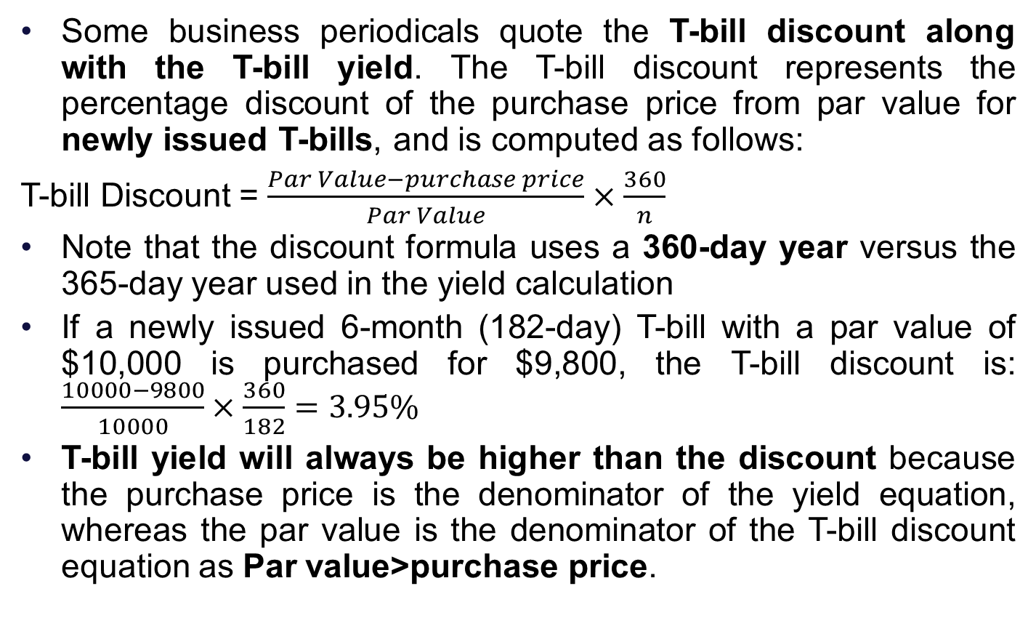
Discount: Treasury Bills (T-bills)
Some business periodicals quote the T-bill discount along with the T-bill yield. The T-bill discount represents the percentage discount of the purchase price from par value for newly issued T-bills, and is computed as follows:
T-bill Discount = $\frac{Par Value−purchase price}{Par Value}×\frac{360}{n}$
Note that the discount formula uses a 360-day year versus the 365-day year used in the yield calculation
If a newly issued 6-month (182-day) T-bill with a par value of $10,000 is purchased for $9,800, the T-bill discount is: $\frac{10000−9800}{10000}×\frac{360}{182}=3.95\%$
T-bill yield will always be higher than the discount because the purchase price is the denominator of the yield equation, whereas the par value is the denominator of the T-bill discount equation as Par value>purchase price.

Slide 10
Commercial Paper
Commercial paper is a short-term debt instrument issued only by well-known, creditworthy firms; it is typically unsecured.
To provide liquidity for working capital management.
An alternative to short-term bank loans (Cheaper as well).
Financial institutions such as finance companies and bank holding companies are major issuers of commercial paper.
Could be issued via private placement, or dealers. In most cases, investors hold commercial paper until maturity.
The minimum denomination of commercial paper is usually $100,000, and typical denominations are in multiples of $1 million.

Slide 11
Commercial Paper…
Retail investors cannot invest directly due to high investments. They can buy MMMFs.
Credit Risk: Yes, hence more return than T-bills. Some investors rely heavily on credit ratings (by Moody’s, Fitch) to assess the credit risk of commercial paper.
Some commercial paper (called junk commercial paper) is rated low or not rated at all.
Some commercial paper is backed by assets of the issuer.
Yield Computation: The yield received by a commercial paper investor can be determined in a manner similar to the T-bill yield, although a 360-day year is normally used.

Slide 12
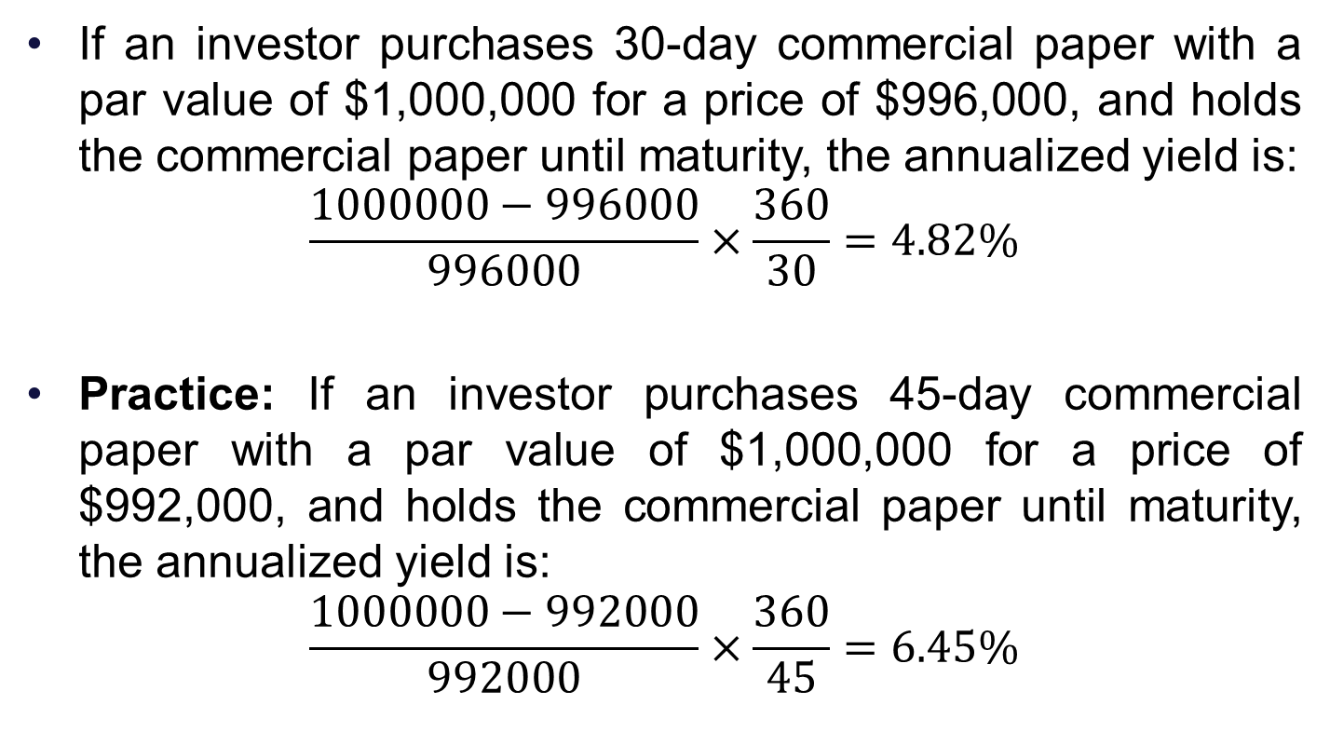
Yield: Commercial Paper
If an investor purchases 30-day commercial paper with a par value of $1,000,000 for a price of $996,000, and holds the commercial paper until maturity, the annualized yield is:
$$\frac{1000000−996000}{996000}×\frac{360}{30}=4.82\%$$
Practice: If an investor purchases 45-day commercial paper with a par value of $1,000,000 for a price of $992,000, and holds the commercial paper until maturity, the annualized yield is:
$$\frac{1000000−992000}{992000}×\frac{360}{45}=6.45\%$$

Slide 13
Negotiable Certificates of Deposit (NCD)
Negotiable certificates of deposit (NCDs) are certificates issued by large commercial banks and other depository institutions as a short-term source of funds.
The minimum denomination is $100,000, although a $1 million denomination is more common.
NCDs are similar to regular certificates of deposit (CDs), but they have a large face value and are negotiable.
It is a fixed deposit receipt that can be sold to a third party on the secondary market (via brokers).
Retail investors cannot invest directly due to high investments. They can buy MMMFs.

Slide 14
NCDs
Maturities on NCDs typically range from two weeks to one year.
Some issuers place their NCDs directly; others use a third party institution that specializes in placing NCDs. Another alternative is to sell NCDs to securities dealers, which in turn resell them.
NCDs must offer a slightly higher yield than T-bills with the same maturity to compensate for their lower liquidity and safety levels.

Slide 15
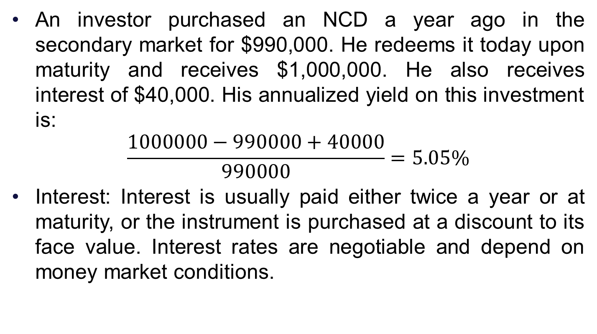
NCDs: Yield
An investor purchased an NCD a year ago in the secondary market for $990,000. He redeems it today upon maturity and receives $1,000,000. He also receives interest of $40,000. His annualized yield on this investment is:
$$\frac{1000000−990000+40000}{990000}=5.05\%$$
Interest: Interest is usually paid either twice a year or at maturity, or the instrument is purchased at a discount to its face value. Interest rates are negotiable and depend on money market conditions.

Slide 16
Repurchase Agreements (Repo)
With a repurchase agreement (or repo), one party sells securities to another with an agreement to repurchase the securities at a specified date and price.
In essence, the repo transaction represents a loan backed by the securities. If the borrower defaults on the loan, the lender has claim to the securities.
Most repo transactions use government securities, although some involve other securities such as commercial paper or NCDs.
A reverse repo refers to the purchase of securities by one party from another with an agreement to sell them.
Thus, a repo and a reverse repo refer to the same transaction but from different perspectives. These two terms are sometimes used interchangeably, so a transaction described as a repo may be a reverse repo.

Slide 17
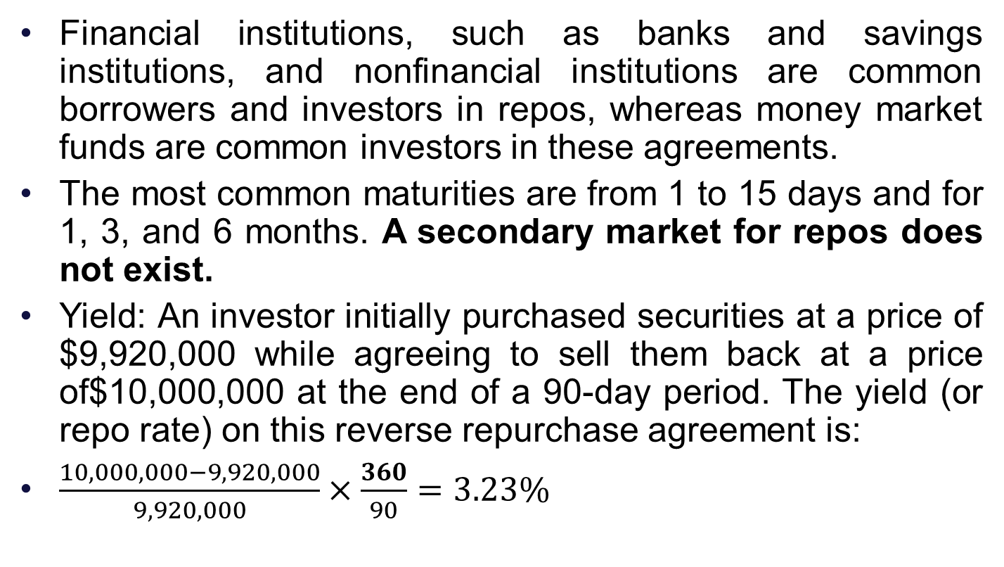
Repurchase Agreements (Repo)…
Financial institutions, such as banks and savings institutions, and nonfinancial institutions are common borrowers and investors in repos, whereas money market funds are common investors in these agreements.
The most common maturities are from 1 to 15 days and for 1, 3, and 6 months. A secondary market for repos does not exist.
Yield: An investor initially purchased securities at a price of $9,920,000 while agreeing to sell them back at a price of$10,000,000 at the end of a 90-day period. The yield (or repo rate) on this reverse repurchase agreement is:
$\frac{10,000,000−9,920,000}{9,920,000}×\frac{360}{90}=3.23\%$

Slide 18
Federal Funds Market
The federal funds rate refers to the interest rate that banks charge other institutions for lending excess cash to them from their reserve balances on an overnight basis (unsecured). Extra cash (wrt to reserve requirements) loaned to other banks.
A lender in the federal funds market is subject to credit risk, since it is possible that the financial institution borrowing the funds could default on the loan.
This rate is influenced by the supply of and demand for funds in the federal funds market. Commercial banks are the most active participants in the federal funds market (for reserve requirements).
This is the rate at which commercial banks borrow and lend their excess reserves to each other (or federal reserve) overnight.

Slide 19
Federal Funds
The federal funds rate is normally slightly higher than the T-bill rate at any given time.
Most loan transactions are for $5 million or more and usually have a maturity of one to seven days.
The stock market is also very sensitive to changes in the federal funds rate. When the Fed cuts rates, for instance, stock markets typically spike higher (low-cost funds, less cost of capital for firms).
The transactions are negotiated through a telecommunications network that links federal funds brokers with participating institutions.

Slide 20
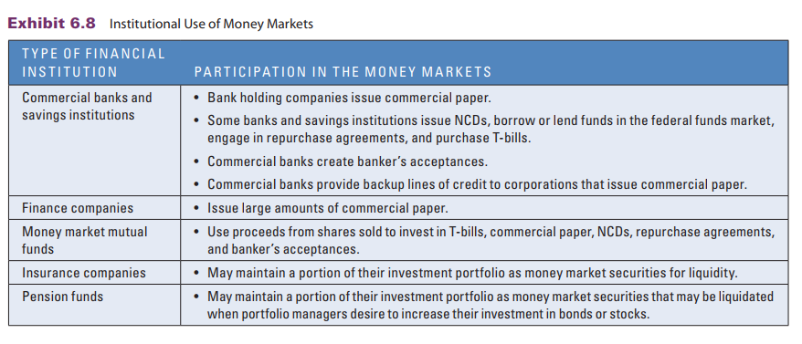
Institutional Use of Money Markets
Source: Book by Jeff Madura

Slide 21
Globalization of Money Markets
Firms need funds for imports or short-term needs (in different currencies).
International banks facilitate the international money markets by accepting deposits and providing loans in a wide variety of currencies.
International markets are well integrated due to liberalization and globalization.
While money market interest rates vary among countries, they tend to move in the same direction over time.
The interest rates of several European countries are the same as a result of the conversion of their currencies to the euro.

Slide 22
International Interbank Market
An international interbank market facilitates the transfer of funds from banks with excess funds to those with deficient funds. It operates on a worldwide basis and conducts transactions in a wide variety of currencies.
The rate charged for a loan from one bank to another in the international interbank market is the London Interbank Offer Rate (LIBOR), which is similar to the federal funds rate in the United States. The term LIBOR is still frequently used, even though many international interbank transactions do not pass through London.
The LIBOR is the average of the reported rates by different banks at a given point in time.
LIBOR is affected by demand and supply in that currency.

Slide 23
Eurodollar Securities
U.S. dollar deposits in non-U.S. banks have grown. These dollar deposits in Europe (or any country) are referred to as Eurodollars. Several types of money market securities utilize Eurodollars.
Eurodollar certificates of deposit are large, dollar-denominated deposits (such as $1 million) accepted by banks in Europe. Only governments and large corporations participate in this market as loan transactions in Eurodollars typically amount to $1 million or more per transaction.
Euronotes are short-term securities issued in bearer form with common maturities of one, three, and six months.
Euro-Commercial Paper: The Euro-CP rate is typically between 50 and100 basis points (a basis point is one hundredth of 1 percent) above LIBOR. Maturities can be tailored to satisfy investors.

Slide 24
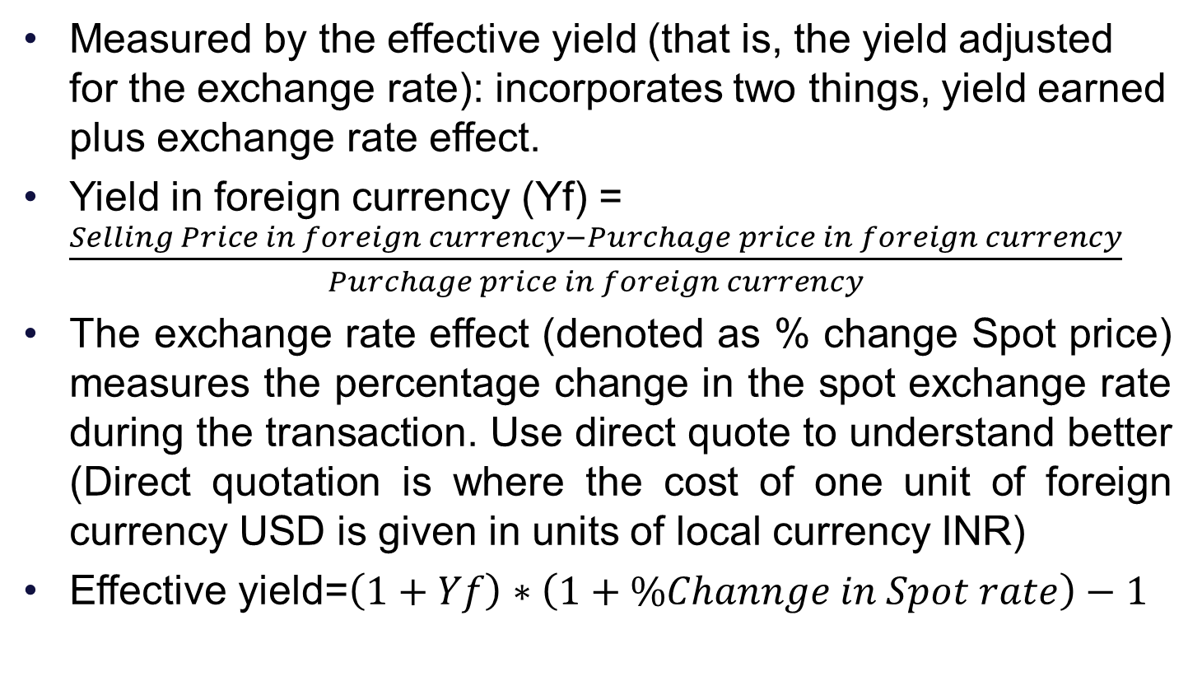
Performance of Foreign Money Market Securities
Measured by the effective yield (that is, the yield adjusted for the exchange rate): incorporates two things, yield earned plus exchange rate effect.
Yield in foreign currency (Yf) = $\frac{Selling Price in foreign currency−Purchage price in foreign currency}{Purchage price in foreign currency}$
The exchange rate effect (denoted as % change Spot price) measures the percentage change in the spot exchange rate during the transaction. Use direct quote to understand better (Direct quotation is where the cost of one unit of foreign currency USD is given in units of local currency INR)
Effective yield=$\left(1+Yf\right)∗\left(1+\%Channge in Spot rate\right)−1$

Slide 25
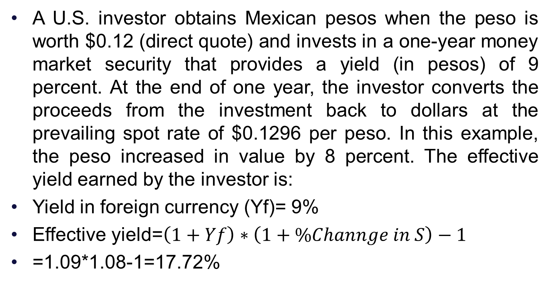
Performance of Foreign Money Market Securities
A U.S. investor obtains Mexican pesos when the peso is worth $0.12 (direct quote) and invests in a one-year money market security that provides a yield (in pesos) of 9 percent. At the end of one year, the investor converts the proceeds from the investment back to dollars at the prevailing spot rate of $0.1296 per peso. In this example, the peso increased in value by 8 percent. The effective yield earned by the investor is:
Yield in foreign currency (Yf)= 9%
Effective yield=$\left(1+Yf\right)∗\left(1+\%Channge in S\right)−1$
=1.09*1.08-1=17.72%

Slide 26
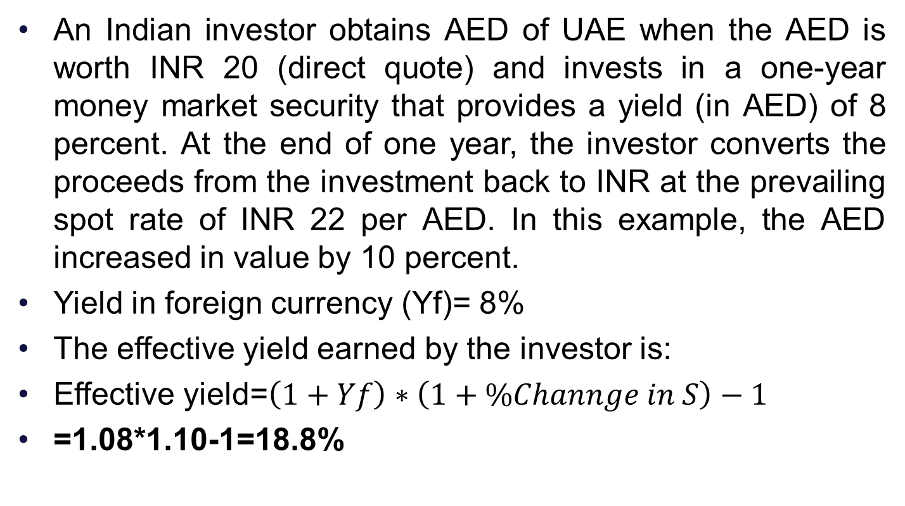
Practice: When AED Appreciates
An Indian investor obtains AED of UAE when the AED is worth INR 20 (direct quote) and invests in a one-year money market security that provides a yield (in AED) of 8 percent. At the end of one year, the investor converts the proceeds from the investment back to INR at the prevailing spot rate of INR 22 per AED. In this example, the AED increased in value by 10 percent.
Yield in foreign currency (Yf)= 8%
The effective yield earned by the investor is:
Effective yield=$\left(1+Yf\right)∗\left(1+\%Channge in S\right)−1$
=1.08*1.10-1=18.8%

Slide 27
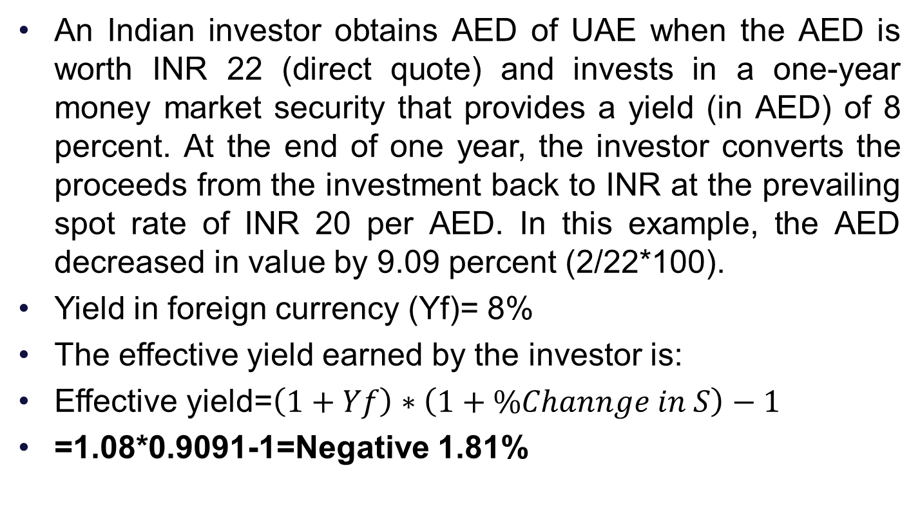
Practice: When AED Depreciates
An Indian investor obtains AED of UAE when the AED is worth INR 22 (direct quote) and invests in a one-year money market security that provides a yield (in AED) of 8 percent. At the end of one year, the investor converts the proceeds from the investment back to INR at the prevailing spot rate of INR 20 per AED. In this example, the AED decreased in value by 9.09 percent (2/22*100).
Yield in foreign currency (Yf)= 8%
The effective yield earned by the investor is:
Effective yield=$\left(1+Yf\right)∗\left(1+\%Channge in S\right)−1$
=1.08*0.9091-1=Negative 1.81%

Slide 28
THANK YOU!!!

